Slide 1
My City Information App
PIP104 PROFESSIONAL PRACTICE-II
VIVA-VOCE
Batch Number: G-17
Roll Number | Student Name
20211LCS0004 | Aanchal Pandey
20211LCS0003 | Sohit Kumar Mahato
20201CSE0153 | Aishvary Pratap Singh
Under the Supervision of,
Dr. Manish M Goswami
Associate Professor
School of Computer Science Engineering & Information Science
Presidency University

Slide 2
Introduction
Creating a complete mobile app for exploring Indian cities aims to offer a wide range of info for travelers, both local and international. Right now, tourists face problems when they can't find trustworthy guides, making their trips more difficult. Hiring guides can be costly, straining many travelers financially. Also, these guides might not always be experts, working only part-time and sometimes struggling to give accurate details because they work seasonally. This proposed mobile app aims to address these issues by offering a cost-effective and easily accessible alternative. By leveraging an Android-based smartphone platform, the app intends to act as a virtual guide, providing essential information about various tourist spots. Its functionalities will include displaying maps of desired locations, calculating distances between places, and offering fundamental details about each tourist attraction. This convenient tool will be readily available for tourists, allowing them to access information crucial for decision-making, such as temperature, altitude, weather conditions, historical significance, and dates related to these spots. The objective is to ensure that tourists have access to accurate and reliable information whenever they need it, eliminating the dependence on potentially unreliable or unavailable guides. This initiative aims to enhance the overall tourist experience by providing a free and accessible solution that caters to their informational needs while exploring cities in India.

Slide 3
Literature Review
[1] This paper explores the creative use of mashup technology in the creation of a mobile tourist guide system. The writers are aware of the increasing demand for cutting-edge technical solutions to improve tourists' travel experiences. They suggest a mobile tourist guide system that makes use of mashup technology in answer to this need. Using mashup technology, several web services and data sources are integrated to provide a single, dynamic application. Within the framework of this research, the authors investigate how mashups might be used to give tourists up-to-date, complete information. The goal of integrating many data sources is to provide visitors traveling to new places with a rich and engaging experience.
Examples of these sources include maps, location-based services, and tourist attractions. The suggested mobile tourist guide system's architectural design, execution, and assessment are probably covered in this article. One may investigate how mashup technology enhances the tourist guide system's usability, accessibility, and overall efficacy. Through referencing this work, scholars and industry professionals get significant insights into the convergence of mobile technology and tourism, particularly concerning the inventive application of mashup technology to generate a more knowledgeable and captivating trip encounter.

Slide 4
[2] The paper examines the use of mobile phones as a platform for providing location-based tourism information in response to the increasing demand for such services.
In the rapidly changing field of information technology, the writers explore how mobile phones might be used as an instrument to improve traveller experiences. Acknowledging the difficulties travellers encounter in obtaining precise and up-to-date information about their environment, the paper presents a novel solution known as "Tour-guide." By utilizing location-based services, this solution aims to give customers up-to-date, pertinent information on neighbouring tourism destinations.
The technical aspects of creating the Tour-guide system are probably covered by the authors, who also highlight the system's usefulness in providing information on local amenities, areas of interest, and other pertinent features.
The user interface, interaction methods, and general architecture of the Tour-guide system may also be covered in detail in this paper. Given how ubiquitous mobile technology is in contemporary society, this paper offers insightful information about how to use mobile devices as a platform to improve the traveller experience by utilizing location-based information services.

Slide 5
[3] This paper discuss about the prevalence of smartphones and the increasing reliance on mobile applications for travel-related information are acknowledged in Jordan's work. The paper's main goal is to shed light on the approaches and factors that need to be considered while creating applications for tourist guides. Through this analysis of multiple mobile development platforms, the author hopes to provide a thorough grasp of the benefits and drawbacks of each platform.
It is likely that the research explores important areas including functionality, user interface design, and the technological nuances of developing mobile apps. It might also cover how important it is to include navigational elements, real-time data, and the user experience in general while developing successful applications for travel guides. This 2013 study is probably going to be a great resource for developers, academics, and professionals looking for a basic understanding of developing mobile applications for the tourist industry as mobile technology advances.

Slide 6
[4] The study looks at how mobile technology is developing and how it might improve traveller experiences. The authors offer a cutting-edge technique for creating applications that are customized to each user's preferences and needs, acknowledging the revolutionary potential of mobile applications in the travel industry. The study acknowledges the dynamic and varied character of tourism activities and looks at ways to develop applications that provide tailored advice, suggestions, and information to improve the trip experience.
It is likely that the conference paper addresses frameworks, algorithms, or methods for incorporating customization elements into mobile travel apps. This can entail making use of user information, preferences, and contextual data to provide tailored recommendations for places to visit, things to do, and lodging. The authors may also discuss the difficulties in creating these customized systems and offer suggestions for improving the usability and efficiency of these mobile apps. In general, the article adds to the expanding corpus of research on mobile technology and tourism by providing methods and insights for designing more individualized and user-focused travel experiences.

Slide 7
[5] The paper's main goal is to address the difficulties that travelers encounter while trying to find accurate and useful information when traveling. To give users an all-inclusive tool for exploring and traversing different locations, the authors suggest implementing a "Smart Travel Guide" mobile application. The platform of choice, Android, emphasizes how important mobile technology is to improving the travel experience. It is possible that the paper explores the technical aspects of the program, going into features including navigation functionalities, real-time information, and user interface design. It may also address the practicality and efficacy of the suggested remedy in resolving typical problems faced by tourists, in line with the current demand for easily available and effective travel help.
This study adds a great deal to the developing field of mobile applications that aim to improve traveler experiences. The study fills a vital gap in contemporary travel by acknowledging the growing dependence on cell phones for information and navigation in a variety of settings. The goal of the suggested Android app Smart Travel Guide is to provide a customized solution that will increase user accessibility and convenience while traveling.

Slide 8
Research Gaps Identified
Research Gaps:
Guides' Reliability: There is a gap in reliable and consistent information provided by guides, who may not always be experts and might offer inaccurate details due to part-time or seasonal work.
Navigation: Users must visit various websites or use different apps for each service like for weather update users’ needs to visit weather update website.
Cost of Hiring Guides: The financial strain of hiring guides is a challenge for many travelers, creating a need for a more cost-effective solution.
Accessibility: There is a gap in easily accessible information about tourist spots, which the proposed app aims to address by leveraging smartphones.

Slide 9
Real time data: Many of the applications provides real time data but not all are accurate and user friendly.
Language Barriers: Travelers often face challenges in communication due to language differences with local guides. This language barrier can hinder the overall experience and understanding of the tourist spots. The app can mitigate this by providing multilingual features, offering information in various languages to cater to a diverse user base.
Integration of Services: The app aims to streamline the travel experience by integrating various services within a single platform. This includes combining weather updates, local transportation information, and nearby dining options to offer users a comprehensive and convenient travel solution.

Slide 10
Proposed Methodology
Requirement Analysis:
Begin by engaging with local communities and potential users to identify the specific information needs. Understand the nuances of the selected city in India, taking into account the diverse requirements of residents and visitors alike. Analyze feedback from community forums, government authorities, and surveys to determine key categories of information essential for inclusion in the app.
API Integration:
Integrate reliable APIs for real-time data on attractions, accommodations, healthcare, education, law enforcement, public representatives, senior citizen services, and transportation. Implement features like search, geolocation, and emergency contacts through APIs.

Slide 11
Proposed Methodology
Geo-Location Integration:
Implement geolocation services using GPS technology to enhance user experience. Enable the app to determine the user's location and provide tailored information based on their proximity to relevant points of interest. This integration ensures that users can quickly access critical information relevant to their current location.
Database Design and Management:
Design a robust database structure with a relational model to efficiently organize and store diverse information. Utilize a well-defined schema to facilitate quick retrieval of data and ensure seamless integration with the app's functionality. Regularly update the database to maintain data accuracy and relevance.

Slide 12
User Interface (UI) Design:
Focus on creating an intuitive and visually appealing UI. Develop wireframes and prototypes to mapout the app's layout and navigation. Prioritize simplicity and clarity in design to accommodate users of varying technical expertise and linguistic backgrounds.
Mobile App Development:
Select a suitable development platform, considering the user base and development resources available. Opt for cross-platform frameworks like React Native or Flutter to ensure compatibility with both Android and iOS devices. Leverage native development tools for Android to enhance performance and user experience.
Integration of External APIs:
Enhance the app's functionality by integrating external APIs for real-time information. Leverage APIs provided by government agencies, weather services, and transportation authorities to ensure users receive accurate and up-to-date details on weather conditions, local transportation options, and emergency services.

Slide 13
Testing and Quality Assurance:
Conduct thorough testing across various devices, screen sizes, and operating systems. Employ functional, usability, and security testing to identify and address potential issues. Ensure the app meets high-quality standards and provides a seamless user experience.
User Feedback and Iterative Development:
Release the app to a limited audience for initial feedback. Collect user reviews, suggestions, and identify areas for improvement. Implement iterative development cycles to refine features, address identified issues, and enhance the overall user interface based on user input.

Slide 14
Deployment and Maintenance:
Deploy the app on relevant app stores after comprehensive testing and refinement. Establish a systematic approach for regular updates and maintenance to address emerging issues, introduce new features, and ensure the app remains current and effective in meeting user needs over time.

Slide 15
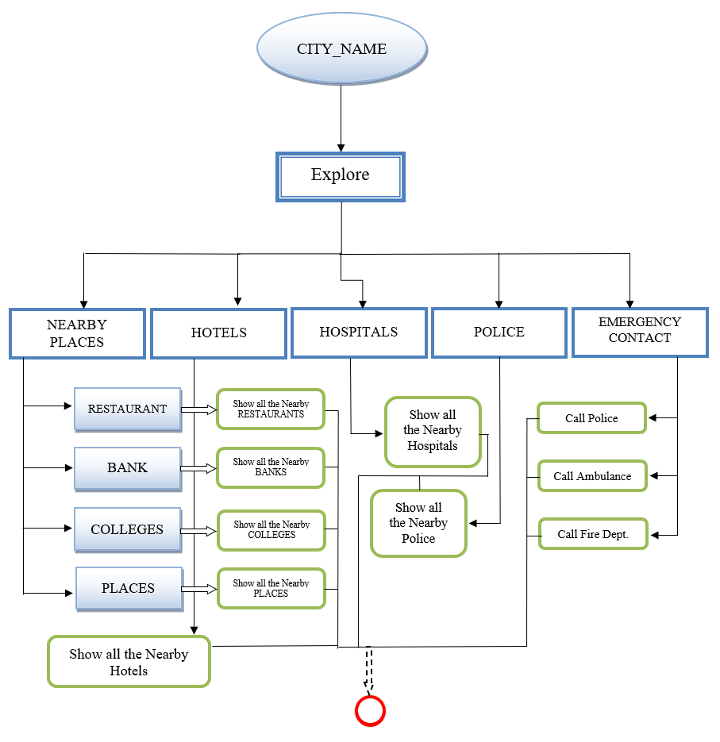

Slide 16
Objectives
The main goal is to create an interface that is easy to use and intuitive that links people to local amenities. For the convenience of users, the platform attempts to provide detailed information on frequently sought-after locations, including ATMs, banks, bus stops, and more. The platform seeks to improve connectivity by effortlessly integrating with users' Facebook and Twitter profiles, making it simple to share experiences and discoveries. In order to give users, access to a range of options catered to their preferences, this interface makes an effort to provide a diverse array of choices within each category of places. Users will find it easy to navigate the platform and find nearby establishments thanks to its intuitive design and functionality, which will facilitate their daily activities and improve their overall community experience. The focus is on integrating location-based data with social media to create a smooth, user-centered experience.

Slide 17
Objectives
Through social media integration, the platform hopes to become a valuable resource for anyone looking for easy access to necessities while also promoting relationships and interactions. The ultimate objective is to empower users by giving them a single point of contact for local information and encouraging social interaction in their community.

Slide 18
System Design & Implementation
1. Platform and Technology:
Platform: Develop the app exclusively for the Android platform using Java for native development.
Technology Stack: Utilize Android Studio as the official Integrated Development Environment (IDE) for Android development. Java, being the primary language for Android, will serve as the core programming language.
2. User Interface (UI) and User Experience (UX):
XML Layouts: Design the UI using XML layout files to create intuitive and user-friendly interfaces.
Activities and Fragments: Leverage Java to handle activities and fragments for managing different screens and components.

Slide 19
System Design & Implementation
3. Core Features:
Google Maps API: Integrate the Google Maps API to incorporate interactive maps and location services.
Distance Calculation: Implement algorithms in Java for calculating distances between locations using latitudeand longitude coordinates.
HTTP Requests: Use Java libraries like HttpURLConnection or third-party libraries like Retrofit for making API requests
to fetch information about tourist spots.
4. Data Management:
SQLite Database: Implement an SQLite database to store and manage information about tourist spots locally on the device.
Content Providers: Use Content Providers to facilitate the interaction between the app and the SQLite database.

Slide 20
System Design & Implementation
5. Accessibility:
Implement a caching mechanism to store essential data locally, enabling users to access information offline.
6. Testing:
JUnit and Espresso: Employ JUnit for unit testing and Espresso for UI testing to ensure the reliability
of your Java code.
Device Emulators: Utilize Android emulators for testing the app on different devices and screen sizes.
7. Security:
HTTPS: Ensure secure communication by using HTTPS for any data transmission between the app & external APIs.

Slide 21
Timeline of Project
Project Initiation (Week 1):
Define goals and objectives
Research and Requirement Analysis (Week 2):
Conduct market research and gather requirements
System Design and Architecture (Week 3-4):
Develop wireframes and prototype
Design user interface (UI) and user experience (UX)

Slide 22
Timeline of Project
Development Phase (Week 5-6):
Front-end development (coding the app's interface)
Back-end development (building the app's functionality)
Testing and Quality Assurance (Week 8):
Testing (debugging, performance, and usability testing)
Final System Integration (Week 9):
Monitor and address initial testing feedback
Documentation (Week 10):
Launch the app in app stores (Google Play Store, Apple App Store)

Slide 23
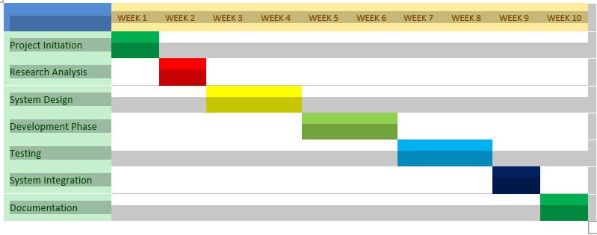
Gantt Chart

Slide 24
Outcomes / Results Obtained
Enhanced Accessibility: The app ensures easy access to important city info for both locals and tourists, making them feel more secure while exploring the city.
Improved Safety and Emergency Assistance:
It provides accurate details about police stations, hospitals, and emergency contacts, boosting public safety and enabling quick responses during emergencies, potentially saving lives.
Tourism Boost:
By highlighting city attractions, hotels, and local events, the app encourages more people to visit, creating positive experiences that benefit the city’s reputation and economy.

Slide 25
Outcomes / Results Obtained
Local Insights and Recommendations:
The app offers insider tips and recommendations from locals, providing unique insights into hidden gems, local eateries, and cultural experiences, enhancing the overall travel experience.
Cultural Exchange and Understanding:
Facilitating connections between travelers and locals fosters cultural exchange, allowing tourists to immerse themselves in the local way of life, promoting mutual understanding and appreciation.

Slide 26
Outcomes / Results Obtained
Result:
The software goes above and beyond the utilitarian features by exploring the historical significance of popular tourist destinations. In addition to pertinent dates and events, users are provided with insights into the cultural legacy of each area, which enhances their overall comprehension and appreciation of the locations they visit.

Slide 27
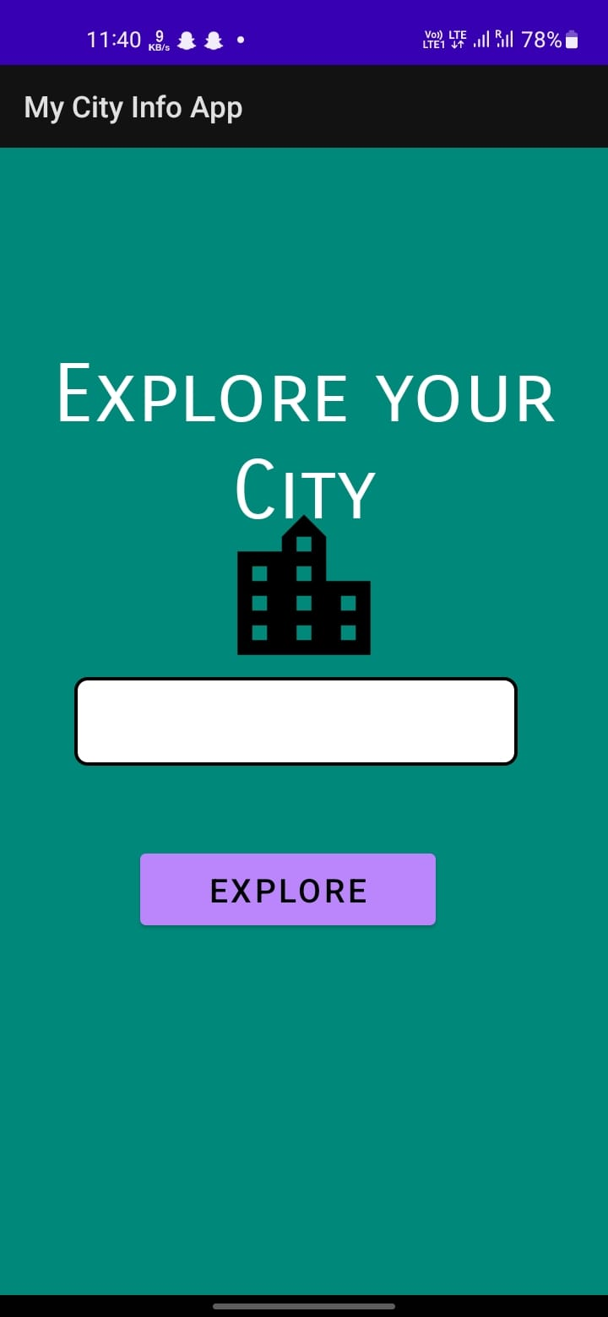
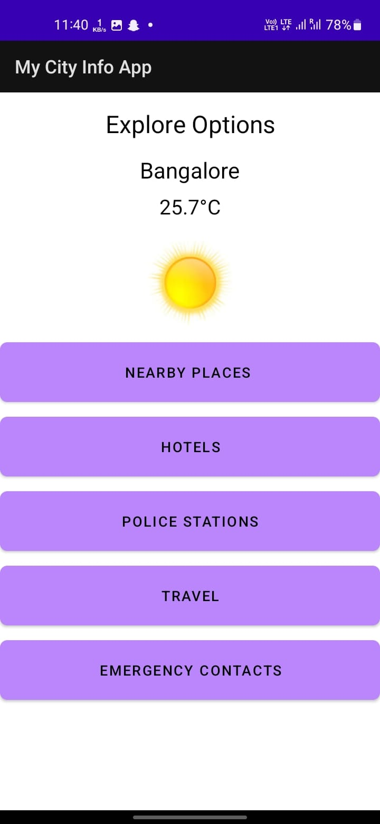
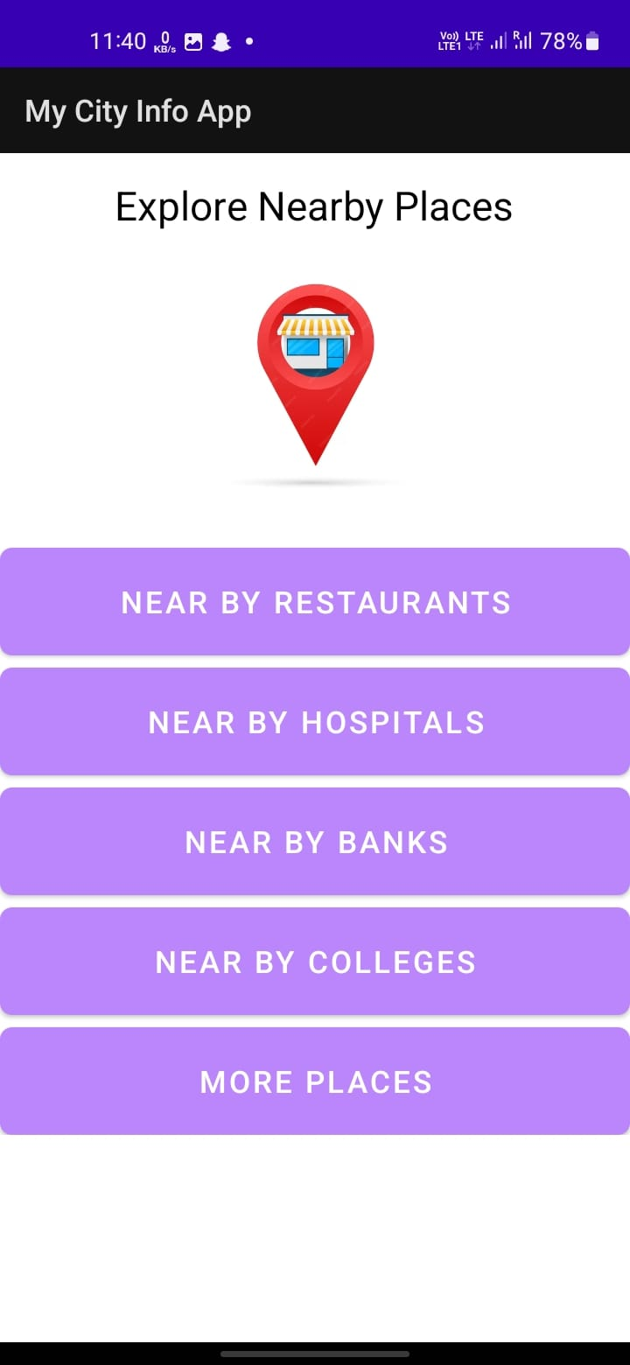
Screenshots

Slide 28
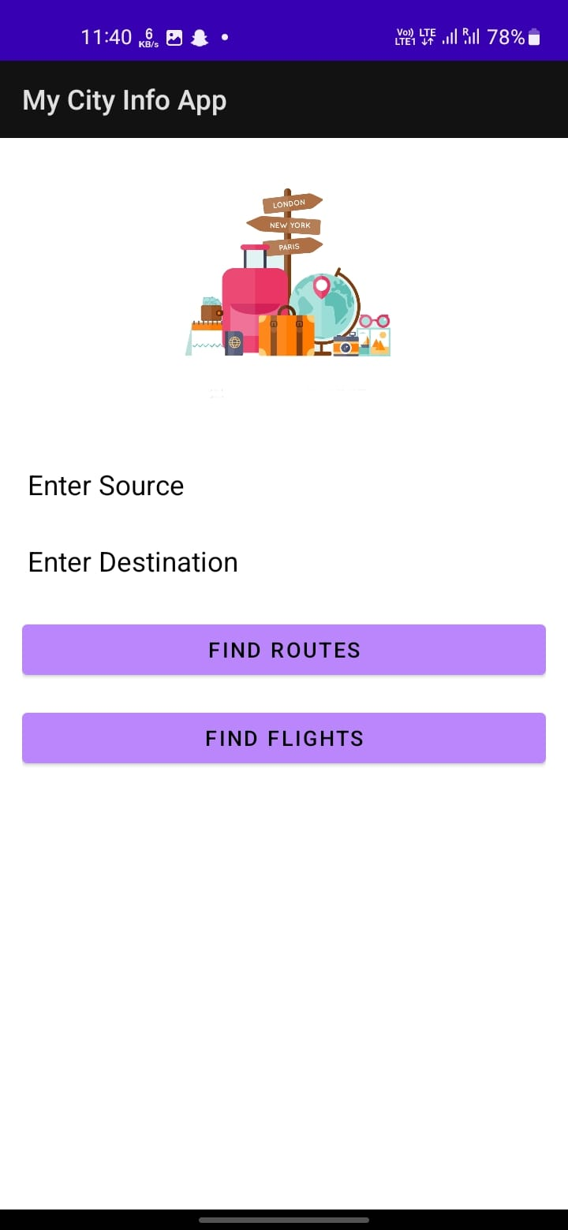
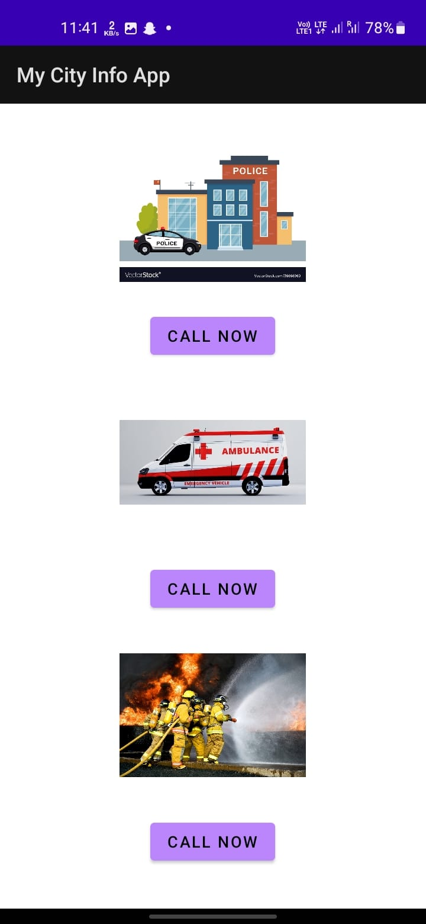

Slide 29
Conclusion
The development of a comprehensive city information mobile app holds the potential to transform urban living in India. By seamlessly integrating essential services, local attractions, and emergency resources, the app not only enhances accessibility and safety but also promotes tourism and community engagement.
Through meticulous planning, robust technology, and continuous user feedback, this initiative stands poised to create more informed, connected, and secure cities. Benefits the residents and visitors but also paves the way for smarter, more efficient urban environments, reflecting the progressive spirit of India's digital future.

Slide 30
References
[1] Meng, J., & Xu, N. (2010, December). A mobile tourist guide system based on mashup technology. In The 2nd International Conference on Information Science and Engineering (pp. 1716-1719). IEEE.
[2] Shi, X., Sun, T., Shen, Y., Li, K., & Qu, W. (2010, June). Tour-guide: Providing location-based tourist information on mobile phones. In 2010 10th IEEE International Conference on Computer and Information Technology (pp. 2397-2401). IEEE.
[3] Jordan, I. (2013). Building mobile tourist guide applications using different development mobile platforms. International Journal of Advanced Science and Technology, 54, 13-22.

Slide 31
References
[4]Kenteris, Michael & Gavalas, Damianos & Economou, Daphne, “A novel method for the development of personalized mobile tourist applications”, International Conference on Communication Systems and Networks, August 2006, 28-30.
[5]Jinendra, D. R., Bhagyashri, J. R., Pranav, G. Y., Seema, V. U., & Parag, A. N. (2012). Smart travel guide: Application for android mobile. International Journal of Electronics, Communication and Soft Computing Science & Engineering (IJECSCSE), 2, 115.

Slide 32

Thank You

